Slide 1

Teaching Resources and Instructors’ Guidelines
Chapter 8: Innovation networks

Slide 2
Chapter 8: Innovation networks
In the following PowerPoint slides you will find the key headings from CHAPTER 8 together with the main illustrations, tables, etc.
There are also slides summarizing the key messages in bullet-point fashion, and a wide range of activities which you can use to help students explore around these themes.
Finally there are some reflection questions which can be used as the basis for discussion or assignments.

Slide 3
Learning Objectives
By the end of this chapter you will develop an understanding of:
how networking helps the process of innovation through improving the range and scale of knowledge interaction
how different types of network can contribute to the process
how effective networks can be designed and operated
how drivers such as globalization and the emergence of Internet infrastructures are shaping an increasingly networked model of innovation.

Slide 4

Core themes and material from the book

Slide 5

How innovation happens?
Process
Success (?)
Notes:
5

Slide 6
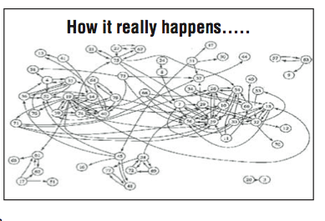
How it really happens
Notes:
6

Slide 7
Why networks?
Collective efficiency
Collective learning
Collective risk-taking
Knowledge intersection

Slide 8
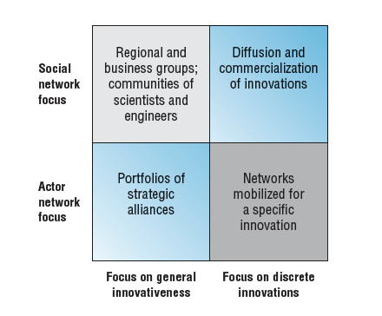
Different network perspectives on innovation

Slide 9
Types of innovation network
Entrepreneur-based
Internal project teams
Internal entrepreneur networks
Communities of practice
Spatial clusters
Sectoral networks
Development consortia

Slide 10
Types of innovation network (continued)
Standards groups
Supply chain learning
Learning networks
Recombinant innovation networks
Managed open innovation networks
User networks
Innovation markets
Crowdsourcing and funding networks

Slide 11
Benefits of learning networks
In shared learning there is the potential for challenge and structured critical reflection from different perspectives .
Different perspectives can bring in new concepts (or old concepts which are new to the learner).
Shared experimentation can reduce perceived and actual costs or risks in trying new things.
Shared experiences can provide support and open new lines of inquiry or exploration.
Shared learning helps explicate the systems principles, seeing the patterns (separating the wood from the trees).
Shared learning provides an environment for surfacing assumptions and exploring mental models outside of the normal experience of individual organizations (helps prevent ‘not invented here’ and other effects).
Shared learning can reduce costs (e.g. in drawing on consultancy services and learning about external markets) which can be particularly useful for small/medium-sized enterprises (SMEs) and for developing country firms.

Slide 12
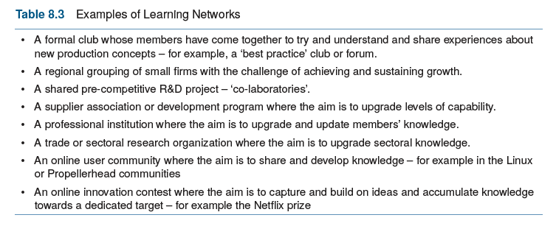
Examples of learning networks

Slide 13
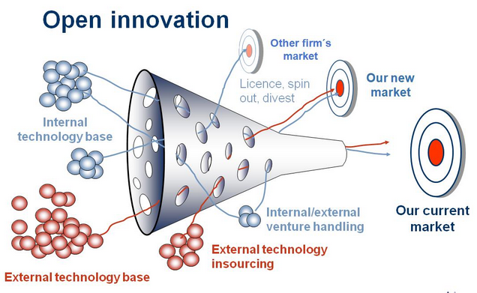
Open innovation

Slide 14
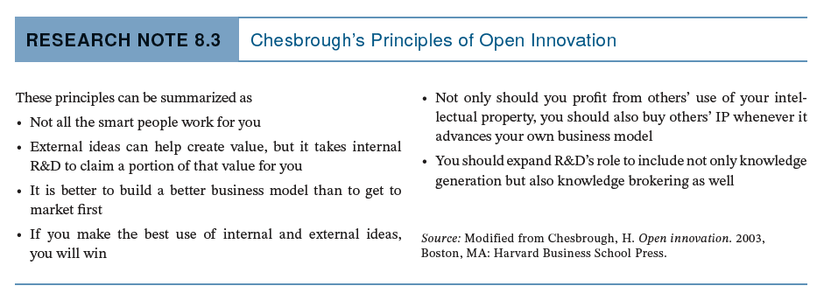
Core principles of open innovation

Slide 15
Models for open innovation
Orchestra
Creative bazaar
Jam Central
Mod station
Infusion

Slide 16
Challenges in open innovation
conditions and context, e.g. environmental uncertainty and project complexity
control and ownership of resources
coordination of knowledge flows
creation and capture of value.

Slide 17
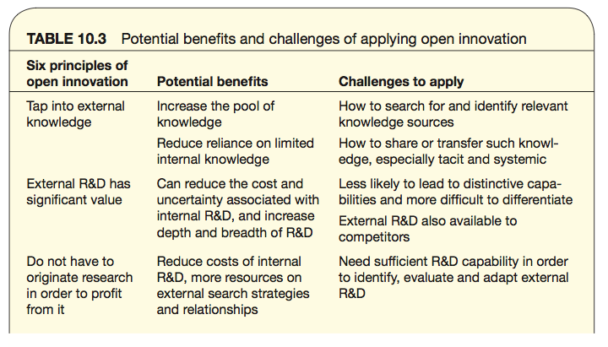
Challenges in open innovation

Slide 18
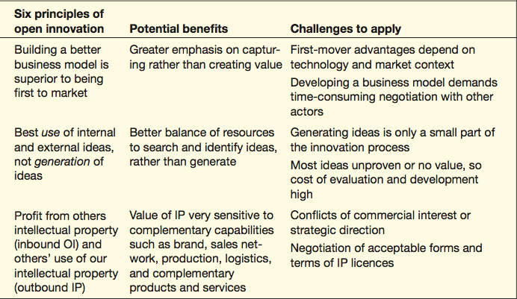
Challenges in open innovation

Slide 19
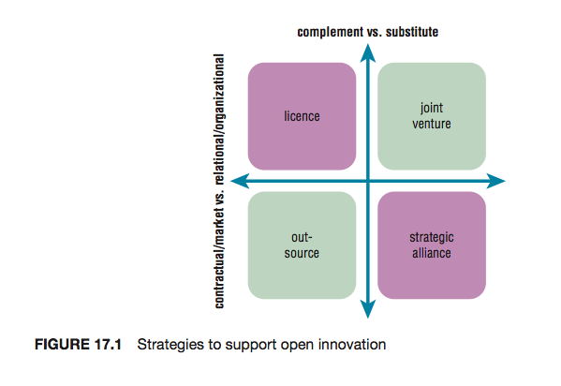
Strategies to support open innovation

Slide 20
Fewer suppliers, longer-term relations
Greater equity – real ‘cost transparency’
Focus on value flows – the relationship, not the contract
Vendor assessment, plus development
Two-way or third-party assessment
Mutual learning – share experience, expertise, knowledge and investment
Characteristics of partnership models

Slide 21
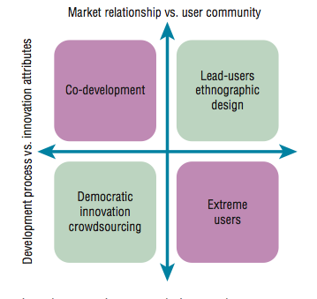
Options in engaging users

Slide 22

Tools for working with open connected innovation
Innovation markets – e.g. innocentive.com
Innovation contests
Innovation communities
Innovation toolkits
Innovation technologies

Slide 23
how to manage something we don’t own or control
how to see system-level effects not narrow self-interests
how to build trust and shared risk taking without tying the process up in contractual red tape
how to avoid ‘free riders’ and information ‘spillovers’
Challenges in building innovation networks

Slide 24
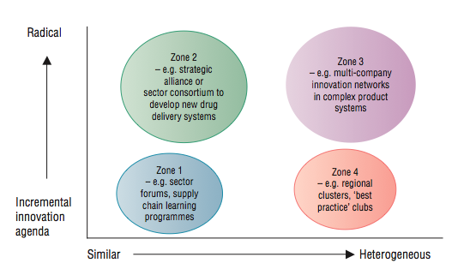
Types of innovation networks

Slide 25
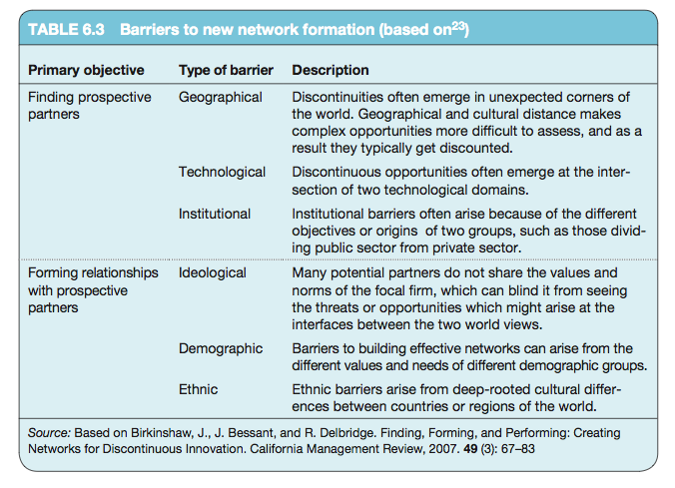
Barriers to new network formation

Slide 26
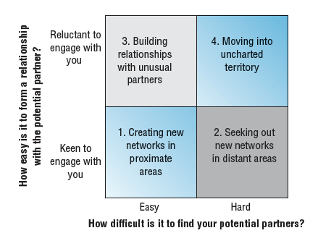
A framework for thinking about new networks

Slide 27
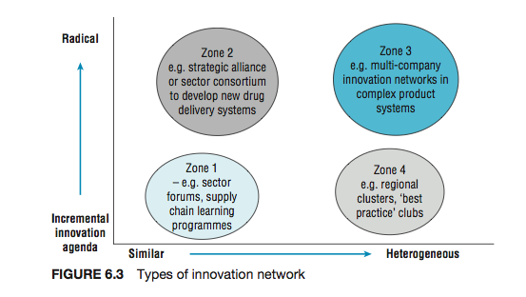
Types of innovation networks

Slide 28
Network boundary management. How the membership of the network is defined and maintained.
Decision making. How (where, when, who) decisions get taken at the network level.
Conflict resolution. How conflicts are resolved effectively.
Information processing. How information flows among members and is managed.
Knowledge management. How knowledge is created, captured, shared and used across the network.
Motivation. How members are motivated to join/remain within the network.
Risk/benefit sharing. How the risks and rewards are allocated across members of the network.
Coordination. How the operations of the network are integrated and coordinated.
Managing innovation networks

Slide 29
Summary
Innovation is not a solo act but a multiplayer game. Be it the entrepreneur who spots an opportunity or an established organization trying to renew its offerings or sharpen up its processes, making innovation happen depends on working with many different players. This raises questions between organizations, developing and making use of increasingly wide networks.

Slide 30
Summary
The ways knowledge actually flows around an innovation project are complex and interactive, woven together in a kind of social spaghetti where different people talk to each other in different ways, more or less frequently, and about different things. As the innovation becomes more complex so the networks have to involve more and different players, many of whom may lie outside the firm.
Increasingly, the networks we have to learn to deal with are becoming more virtual, a rich and global set of human resources distributed and connected by the enabling technologies of the Internet, broadband and mobile communications and shared computer networks.

Slide 31
Summary
Innovation networks are more than just ways of assembling and deploying knowledge in a complex world. They can also have what are termed ‘emergent properties’, that is the potential for the whole to be greater than the sum of its parts. These include getting access to different and complementary knowledge sets, reducing risks by sharing them, accessing new markets and technologies and otherwise pooling complementary skills and assets.
Open innovation is a very broad and therefore popular concept, but needs to be applied with care as its relevance is sensitive to the context. The appropriate choice of partner and specific mechanisms will depend on the type of innovation project and environmental uncertainty.

Slide 32
Summary
Users can contribute to all phases of the innovation process, acting as sources, designers, developers, testers and even the main beneficiaries of innovation.
Lead users are by definition atypical, but anticipate the needs of the majority and recognize requirements early, expect high level of benefits and have sufficient sophistication to identify and capabilities to contribute to the development of the innovation.

Slide 33
Summary
Operating within an innovation network is not easy. It needs a new set of management skills and it depends on the starting point. The challenges include:
how to manage something we don’t own or control
how to see system-level effects not narrow self-interests
how to build trust and shared risk taking without tying the process up in contractual red tape
how to avoid ‘free riders’ and information ‘spillovers’.

Slide 34

Videos
There are several videos which can help explore and present the key themes of the chapter:
Open innovation – managing knowledge spaghetti
Open innovation – a golden opportunity?
Strategies for open innovation
Innovation contests and markets
Notes:
Short videos

Slide 35
Videos
Managing knowledge spaghetti - John Bessant talks about some of the challenges of managing innovation in networked fashion
Interview with David Simoes-Brown explaining the core challenges in open innovation

Slide 36
Entrepreneur’s networks
This video explores the HoneyBee network approach being used in India to support innovation
And this video has Chris Anderson talking about the ‘maker revolution’ and the entrepreneurial networks which are forming around ‘tech shops’ and ‘fab labs’.

Slide 37
Benefits of learning networks
Follow the link below to read an interview with Lola Hoad, founder of One Girl Band, a female co-working space and online network designed to facilitate collaboration, promote ideas sharing and foster equal footing with their male counterparts.
http://www.growthbusiness.co.uk/female-entrepreneurs-one-girl-band-2551795/

Slide 38
Crowdsourcing
Follow the link below to hear an interview with Perry Chen, principal founder of the crowdfunding platform, Kickstarter.
https://www.stitcher.com/podcast/national-public-radio/how-i-built-this/e/50961272

Slide 39
Blogs and podcasts
There are several podcasts and blog pieces picking up key themes around managing innovation as a process and some of the key variables:

Slide 40
Media: Ordnance Survey
This is an audio interview with David Overton describing the approach of a large knowledge-based organization to try and extend the range of products and services using their core knowledge base.

Slide 41
Crowdsourcing
This is a video of a TED talk given by Jimmy Wales, founder of Wikipedia describing the idea of crowdsourcing knowledge

Slide 42
Activities
There are a variety of activities (for both groups and individuals and for online as well as offline work. These include:

Slide 43
Activity: Open innovation in practice
Ask students to find examples of open innovation practices and try to classify against the models.

Slide 44
Activity: Strengths and weaknesses of open innovation
Ask students to discuss (with examples) the strengths and weaknesses of taking a more open approach. For example, open innovation spreads the net more widely to find ideas – but it also raises big problems around intellectual property protection.
Present the results in the form of a table contrasting the two.

Slide 45
Team-based exercises
1. ‘Many hands make light work’ – or ‘Too many cooks spoil the broth’? Using examples show why networking may be a positive or negative element in enabling successful innovation. Split the group to present both sides of this argument and run the discussion as a debate.
2. Try and construct a map of the innovation network which leads to creating and delivering a new product like a new mobile phone or mp3 player.

Slide 46
Cases
There are several case studies on the website which highlight key themes in the chapter, including:
Learning networks in action
Liberty Global and Lufthansa Systems mobilizing internal networks for innovation
Procter & Gamble and their ‘Connect and develop’ approach and of 3M and their work with ‘lead user’ networks
Supply chain learning
Local Motors, Threadless and Lego that highlight the use of external communities for innovation
Lifeline Energy illustrating networking challenges and relationship maintenance

Slide 47
Innovation markets - Innocentive
The innocentive website provides an interesting example of an innovation market.
http://www.innocentive.com/

Slide 48
Assessments
The following slides offer some example assessment questions and discussion themes for individual or group activity

Slide 49
Assessments
1. Michael Dell didn’t invent the computer – but he built one of the most successful businesses selling them. Discuss how he makes use of a networking approach to build and sustain a competitive edge in his business.
2. Why might Joe Bloggs, famous inventor, need help in getting his great idea into widespread use? And how might a networking approach help him?
3. Is innovation a solo act? – the product of the lone genius. Show how successful entrepreneurs make use of networks to help take their ideas forward.

Slide 50
Assessments
4. List three advantages of co-operating across networks in innovation as opposed to a ‘go –it-alone’ approach.
5. Jane Wilson has come up with a great new idea for a medical sensor to help in monitoring babies while they sleep. How could she improve her chances of success with her new product idea by using a networking approach to taking it forward?

Slide 51
Assessments
6. ‘The problem for small firms isn’t that they’re small – it’s that they’re isolated’. How might networking help deal with the challenges of being an innovative small firm and what advantages might this approach offer?
7. XYZ Electronics want to launch a supplier development programme to get their 180 suppliers to participate more fully in the innovation process- contributing new ideas for products and services and helping improve processes around quality, delivery and cost reduction. What issues should they think about in designing and implementing such a programme?
8. ‘Open innovation’ is becoming a fashionable approach to innovation, building on the advantages of networking. But what problems might the implementation of such an approach throw up?

